Slide 1






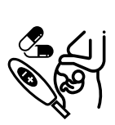


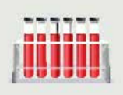
HIV Viral Load Suppression
Knowledge of HIV Positive Status
ART Coverage
Sex and Age
Antenatal Care
Laboratory
HIV Self Testing
Reporting Rates
On Treatment
Blood Tests Done

Slide 2


Slide 3


Slide 4


Slide 5
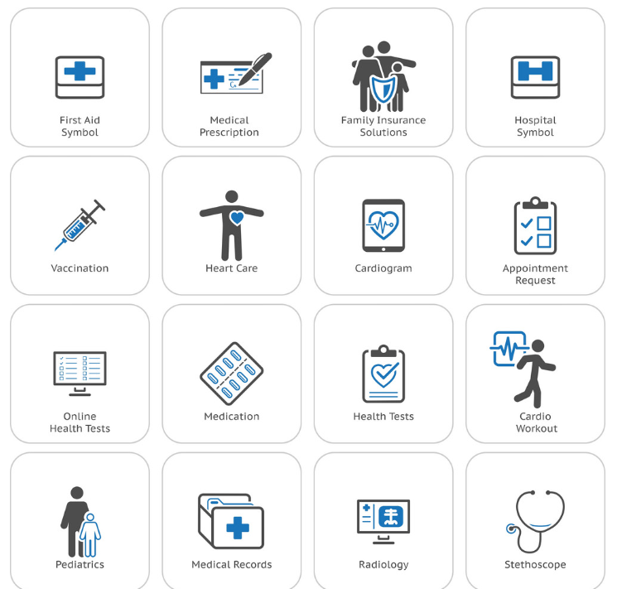

Slide 6


